Slide 1

Demystifying Python’s Internals
Diving into CPython by implementing a pipe operator
Sebastiaan Zeeff
PyCon US 2022

Slide 2







Sebastiaan Zeeff
@SebastiaanZeeff

Slide 3
Talk Outline
We're going to dive into CPython's Internals, including:
Tokens, Grammar, & the PEG parser
Abstract Syntax Trees (AST)
The compiler, bytecode, and "opcodes" (instructions)
The Evaluation Loop
We'll do that by implementing a pipe operator
Due to time constraints, this talk will feature:
Blatant omissions
Gross oversimplifications

Slide 4
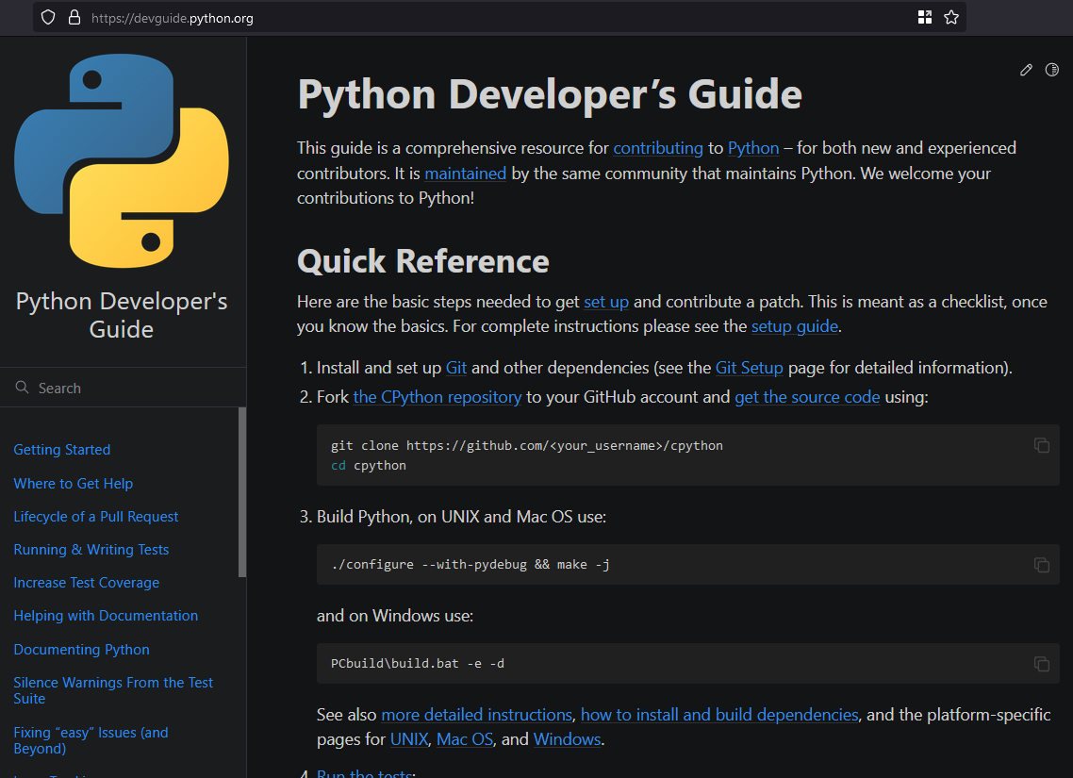
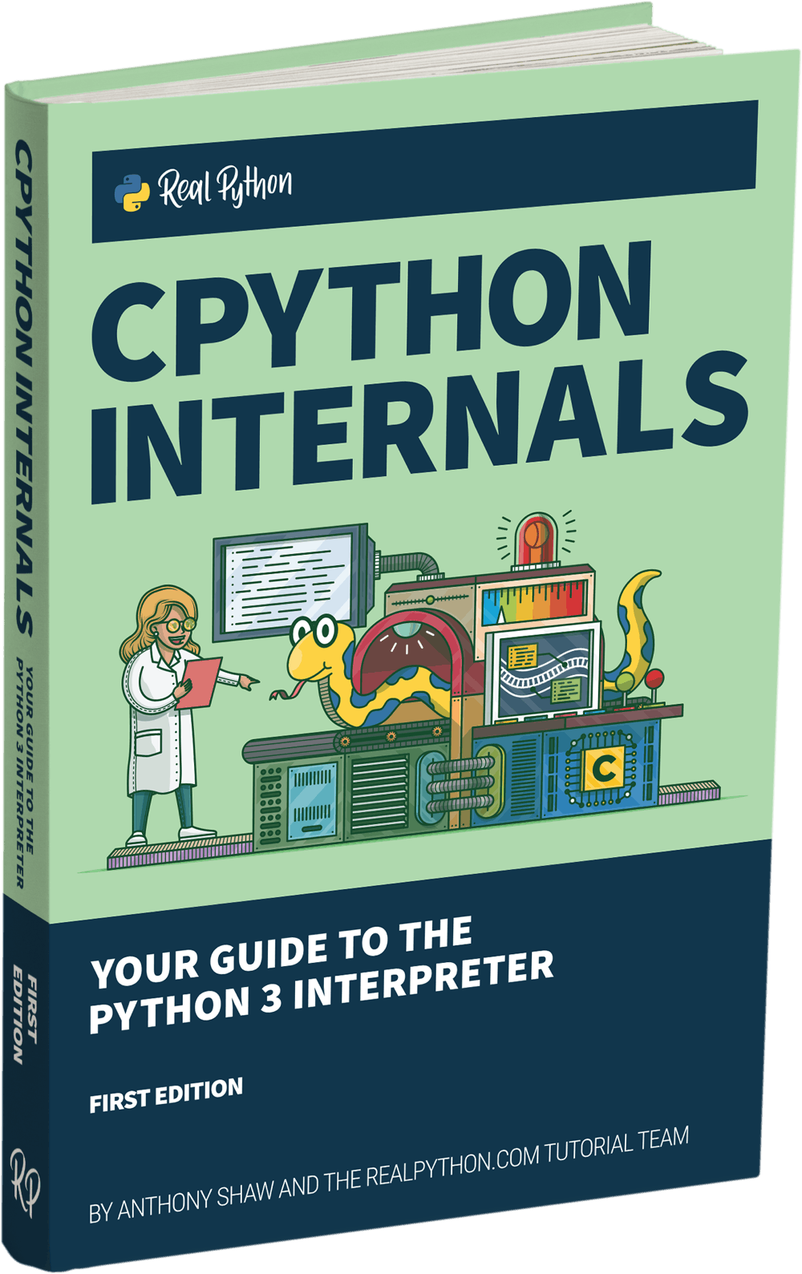
Python Developer’s Guide
https://devguide.python.org
CPython Internals
Anthony Shaw & Real Python

Slide 5
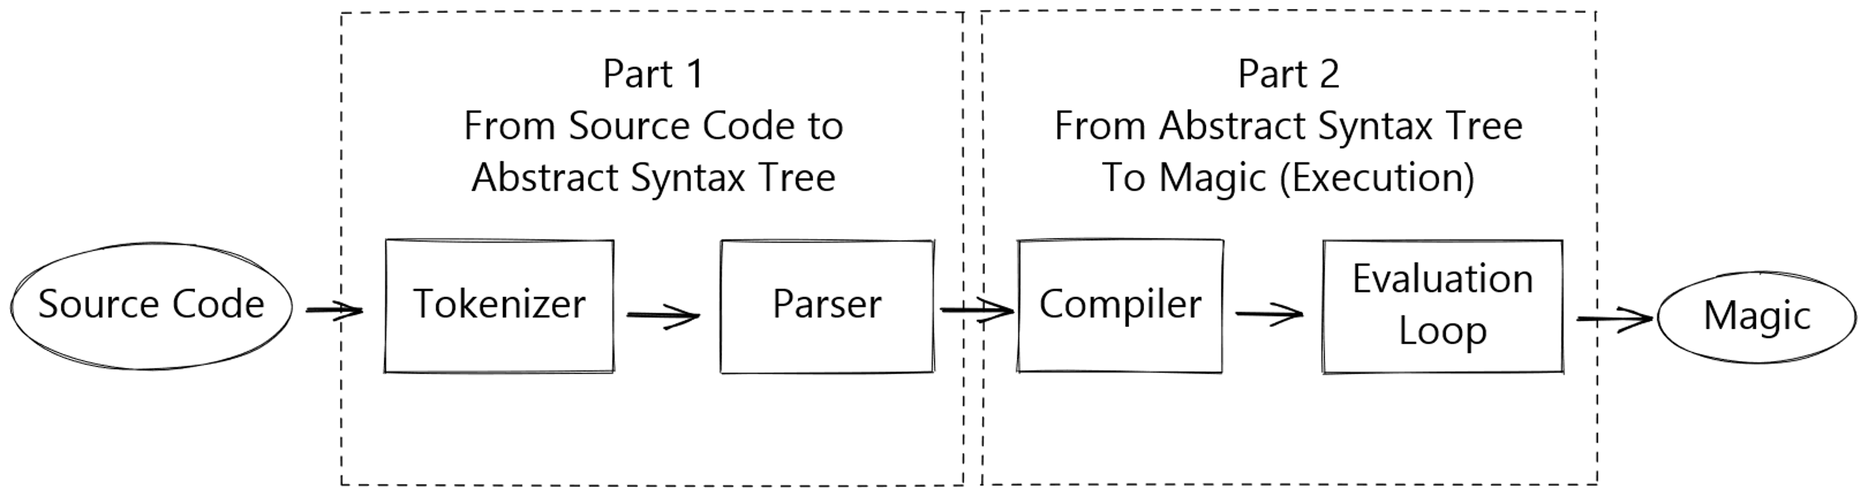
From source code to execution
Source code & slides are available on GitHub:
https://github.com/SebastiaanZ/pypethon

Slide 6
Adding a new binary operator: A pipe operator (|>)
>>> def double(number):
... return number * 2
>>>

Slide 7
Adding a new binary operator: A pipe operator (|>)
>>> def double(number):
... return number * 2
>>> 1 |> double # double(1)
2
>>>

Slide 8
Adding a new binary operator: A pipe operator (|>)
>>> def double(number):
... return number * 2
>>> 1 |> double # double(1)
2
>>> 1 |> double |> double # double(double(1))
4

Slide 9
Adding a new binary operator: A pipe operator (|>)
>>> def double(number):
... return number * 2
>>> 1 |> double # double(1)
2
>>> 1 |> double |> double # double(double(1))
4
Just to be clear: This operator is not a part of Python.
I don’t think there are any plans to add such an operator to Python.
The implementation is purely educational: Feel free to try and extend it!

Slide 10
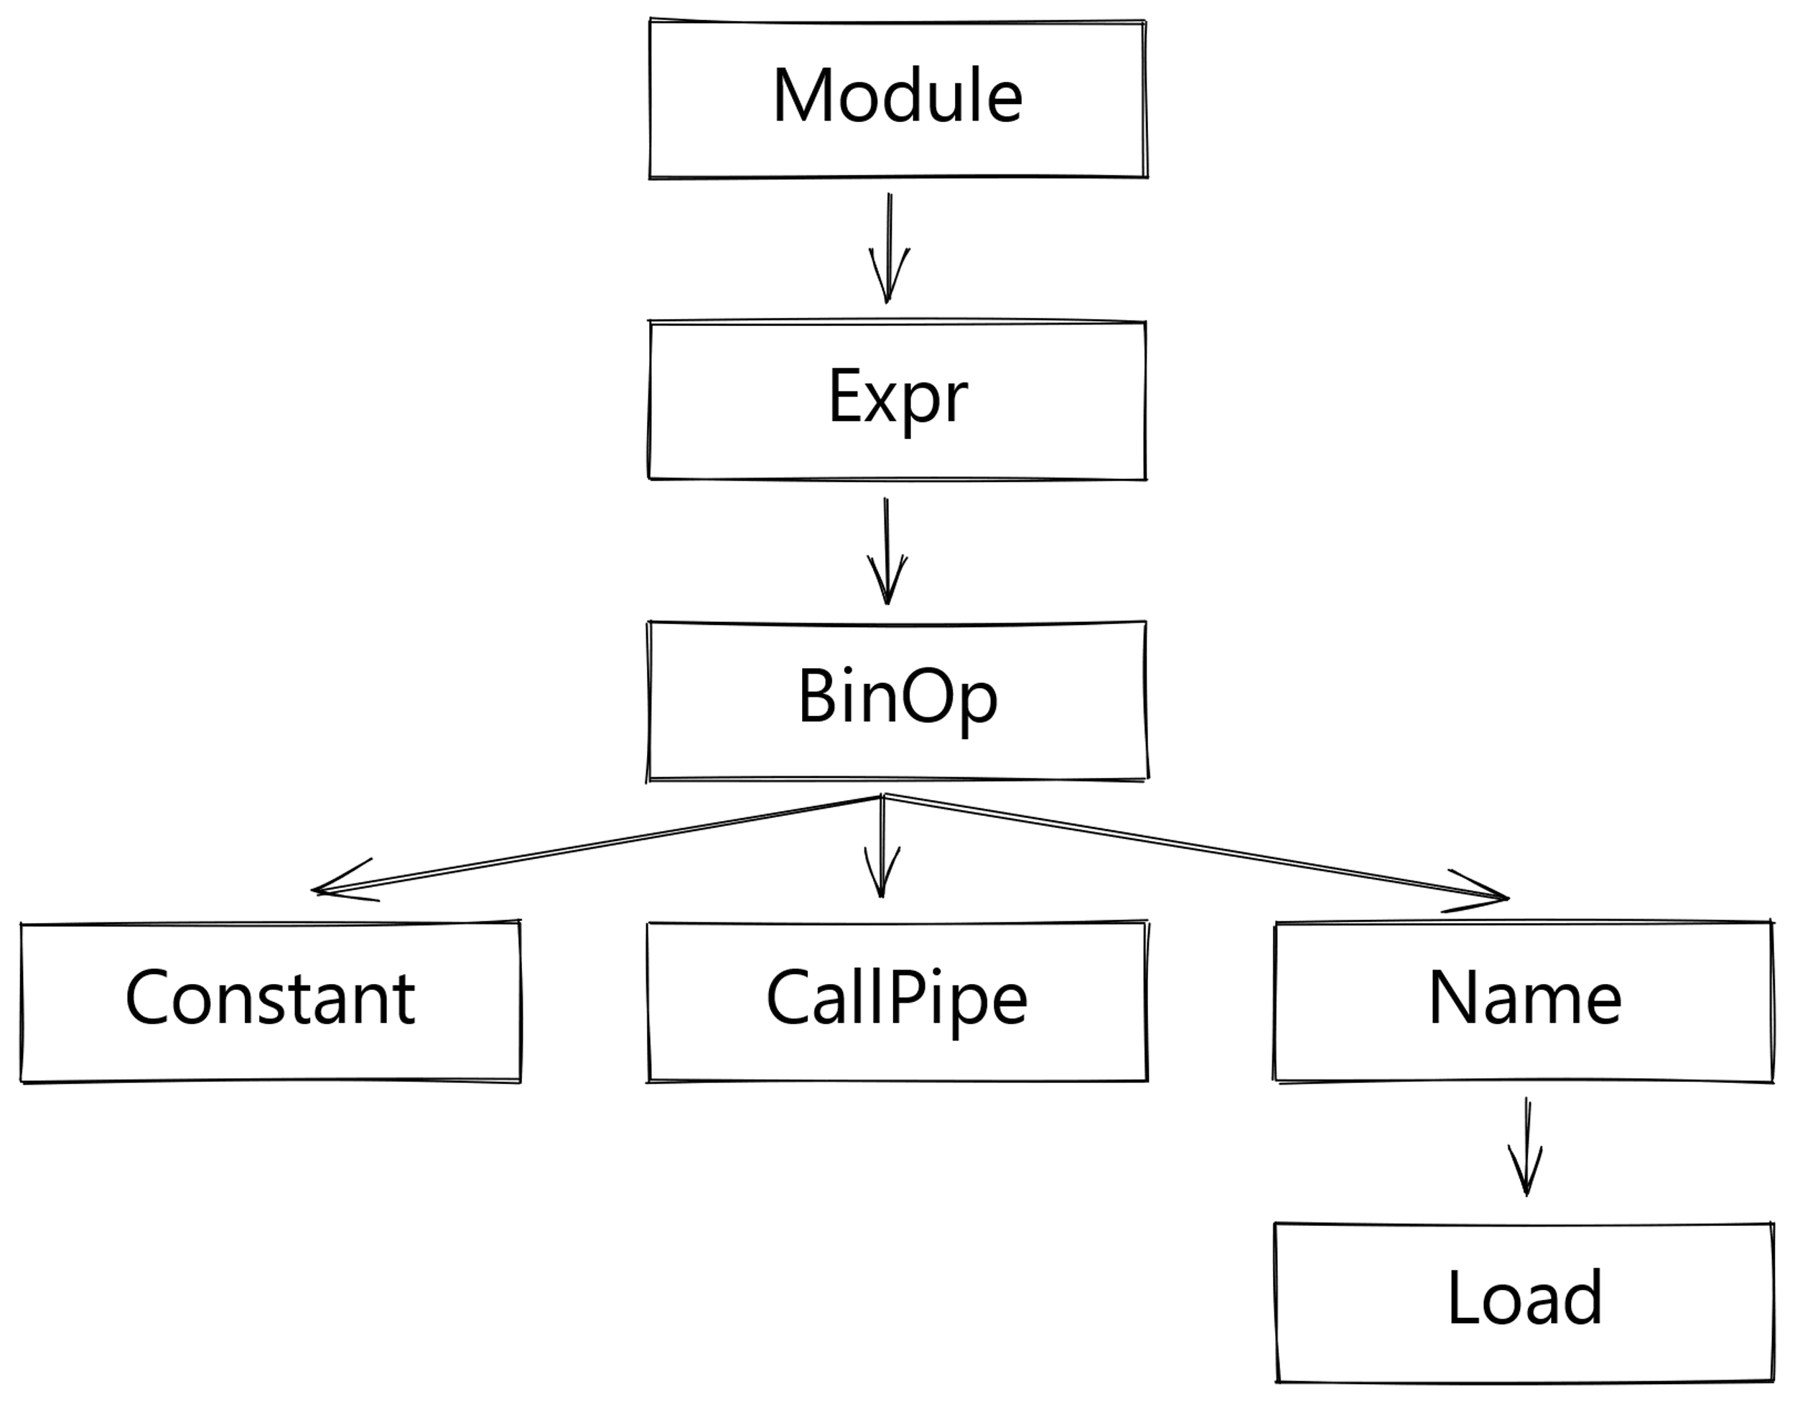
Part I: From Source Code to Abstract Syntax Tree (AST)
10 |> double

Slide 11
Tokenization: from raw text to a stream of tokens
10 |> double
NUMBER
token
???
token
NAME
token

Slide 12
Tokenization: Add a token for the operator
File: Grammar/Tokens
# (...)
ATEQUAL '@='
RARROW '->'
ELLIPSIS '...'
COLONEQUAL ':='
VBARGREATER '|>'
Linux/Mac
$ make regen-token
Windows
> PCBuild\build.bat --regen

Slide 13
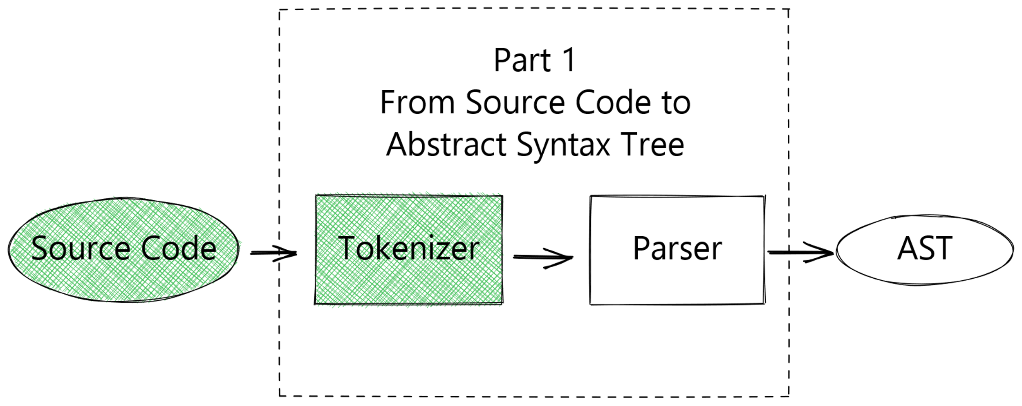
Part 1: Progress
To do in part 1:
Add support for the operator in the grammar
Add support for the operator in the AST

Slide 14
Python's Grammar & the PEG Parser
We need to add a grammar rule for the pipe operator
For that, we'll need to use Parsing Expression Grammar (PEG) syntax

Slide 15
Python's Grammar & the PEG Parser
We need to add a grammar rule for the pipe operator
For that, we'll need to use Parsing Expression Grammar (PEG) syntax
sum:
| atom '+' atom
| atom
atom:
| NUMBER

Slide 16
Python's Grammar & the PEG Parser
We need to add a grammar rule for the pipe operator
For that, we'll need to use Parsing Expression Grammar (PEG) syntax
sum:
| atom '+' atom
| atom
atom:
| NUMBER

Slide 17
Python's Grammar & the PEG Parser
We need to add a grammar rule for the pipe operator
For that, we'll need to use Parsing Expression Grammar (PEG) syntax
sum:
| atom '+' atom
| atom
atom:
| NUMBER
1

Slide 18
Python's Grammar & the PEG Parser
We need to add a grammar rule for the pipe operator
For that, we'll need to use Parsing Expression Grammar (PEG) syntax
sum:
| atom '+' atom
| atom
atom:
| NUMBER
1 + 2

Slide 19
Python's Grammar & the PEG Parser
We need to add a grammar rule for the pipe operator
For that, we'll need to use Parsing Expression Grammar (PEG) syntax
sum:
| atom '+' atom
| atom
atom:
| NUMBER
1 + 2 + 3

Slide 20
Python's Grammar & the PEG Parser
We need to add a grammar rule for the pipe operator
For that, we'll need to use Parsing Expression Grammar (PEG) syntax
sum:
| sum '+' atom
| atom
atom:
| NUMBER
1 + 2 + 3

Slide 21
Python's Grammar & the PEG Parser
We need to add a grammar rule for the pipe operator
For that, we'll need to use Parsing Expression Grammar (PEG) syntax
10 |> double |> triple |> double |> print

Slide 22
Implementing our new grammar rule
File: Grammar/python.gram
shift_expr[expr_ty]:
| a=shift_expr '<<' b=sum { _Py_BinOp(a, LShift, b, EXTRA) }
| a=shift_expr '>>' b=sum { _Py_BinOp(a, RShift, b, EXTRA) }
| sum
sum[expr_ty]:
| a=sum '+' b=term { _Py_BinOp(a, Add, b, EXTRA) }
| a=sum '-' b=term { _Py_BinOp(a, Sub, b, EXTRA) }
| term
# (...)

Slide 23
Implementing our new grammar rule
File: Grammar/python.gram
shift_expr[expr_ty]:
| a=shift_expr '<<' b=sum { _Py_BinOp(a, LShift, b, EXTRA) }
| a=shift_expr '>>' b=sum { _Py_BinOp(a, RShift, b, EXTRA) }
| sum
sum[expr_ty]:
| a=sum '+' b=term { _Py_BinOp(a, Add, b, EXTRA) }
| a=sum '-' b=term { _Py_BinOp(a, Sub, b, EXTRA) }
| term

Slide 24
Implementing our new grammar rule
File: Grammar/python.gram
shift_expr[expr_ty]:
| a=shift_expr '<<' b=sum { _Py_BinOp(a, LShift, b, EXTRA) }
| a=shift_expr '>>' b=sum { _Py_BinOp(a, RShift, b, EXTRA) }
| sum
pipe[expr_ty]:
| pipe '|>' sum
| sum
sum[expr_ty]:
| a=sum '+' b=term { _Py_BinOp(a, Add, b, EXTRA) }
| a=sum '-' b=term { _Py_BinOp(a, Sub, b, EXTRA) }
| term

Slide 25
Implementing our new grammar rule
File: Grammar/python.gram
shift_expr[expr_ty]:
| a=shift_expr '<<' b=sum { _Py_BinOp(a, LShift, b, EXTRA) }
| a=shift_expr '>>' b=sum { _Py_BinOp(a, RShift, b, EXTRA) }
| sum
pipe[expr_ty]:
| pipe '|>' sum
| sum
sum[expr_ty]:
| a=sum '+' b=term { _Py_BinOp(a, Add, b, EXTRA) }
| a=sum '-' b=term { _Py_BinOp(a, Sub, b, EXTRA) }
| term

Slide 26
Implementing our new grammar rule
File: Grammar/python.gram
shift_expr[expr_ty]:
| a=shift_expr '<<' b=pipe { _Py_BinOp(a, LShift, b, EXTRA) }
| a=shift_expr '>>' b=pipe { _Py_BinOp(a, RShift, b, EXTRA) }
| pipe
pipe[expr_ty]:
| pipe '|>' sum
| sum
sum[expr_ty]:
| a=sum '+' b=term { _Py_BinOp(a, Add, b, EXTRA) }
| a=sum '-' b=term { _Py_BinOp(a, Sub, b, EXTRA) }
| term

Slide 27
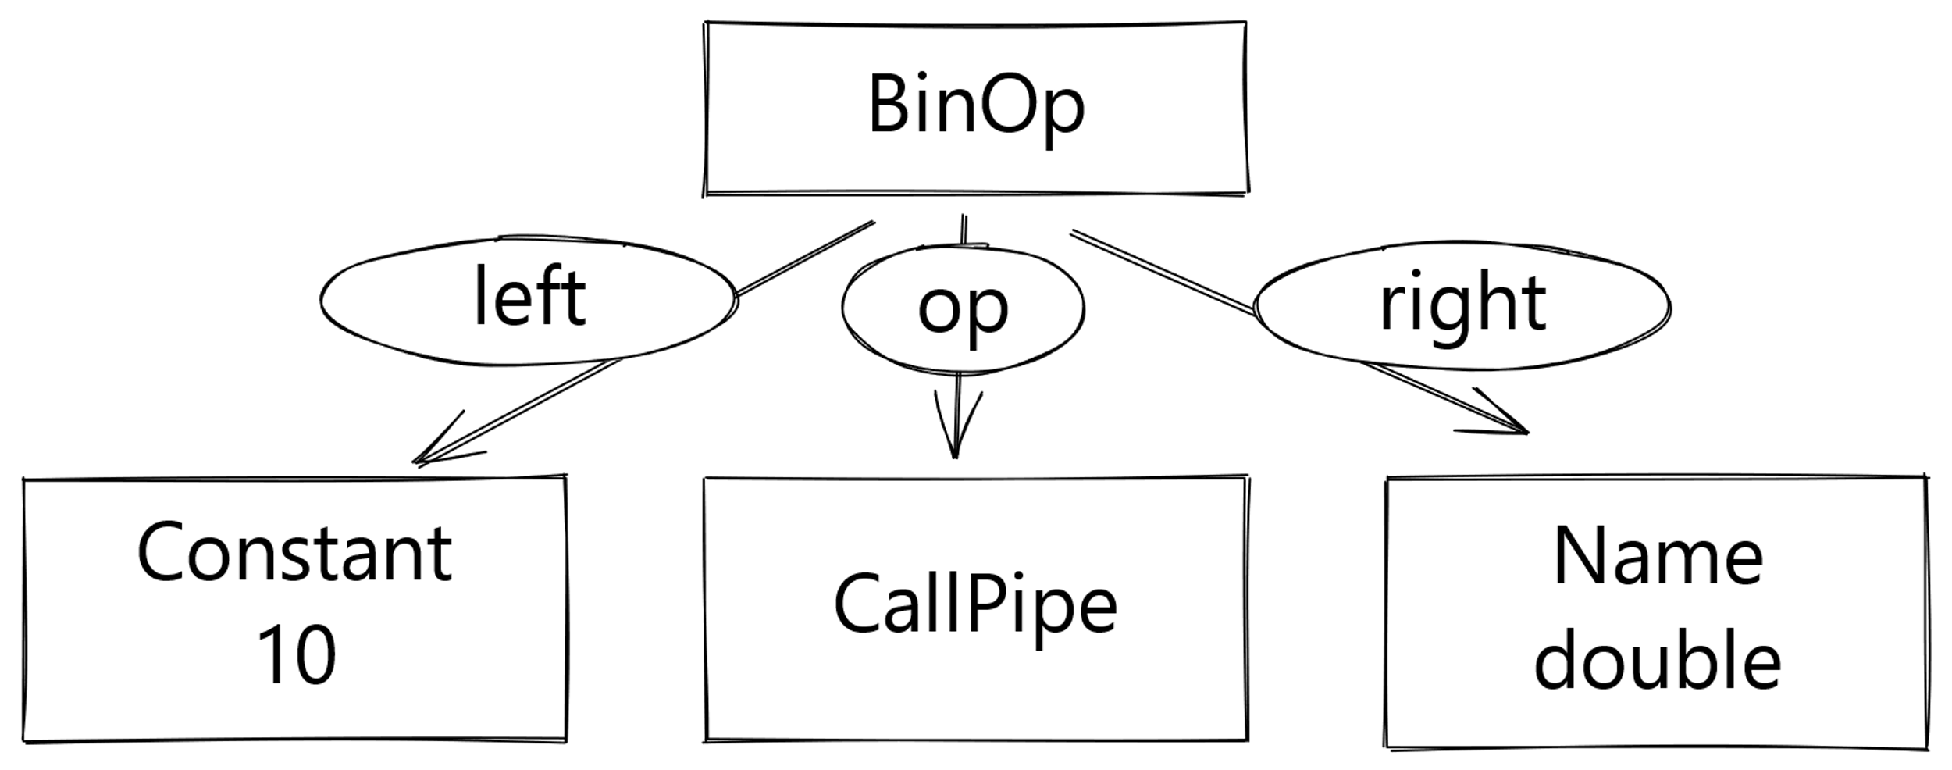

Grammar Actions: from a match to an AST node
PARSED!
10 |> double

Slide 28
Grammar Actions: from a match to an AST node
10 |> double
pipe[expr_ty]:
| pipe '|>' sum
| sum
sum[expr_ty]:
| a=sum '+' b=term { _Py_BinOp(a, Add, b, EXTRA) }

Slide 29
Grammar Actions: from a match to an AST node
10 |> double
pipe[expr_ty]:
| pipe '|>' sum
| sum
sum[expr_ty]:
| a=sum '+' b=term { _Py_BinOp(a, Add, b, EXTRA) }

Slide 30
Grammar Actions: from a match to an AST node
10 |> double
pipe[expr_ty]:
| a=pipe '|>' b=sum { _Py_BinOp(a, CallPipe, b, EXTRA) }
| sum
sum[expr_ty]:
| a=sum '+' b=term { _Py_BinOp(a, Add, b, EXTRA) }

Slide 31
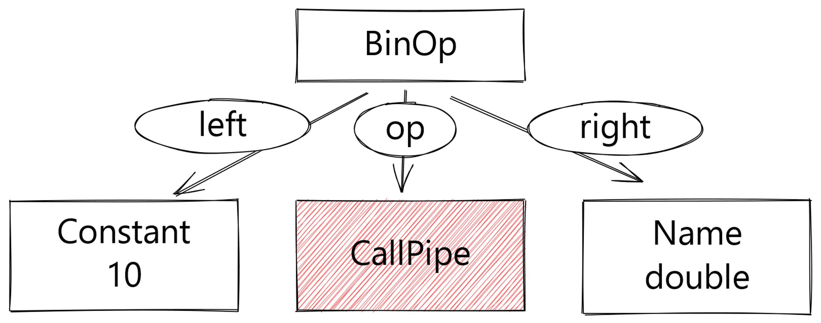
Grammar Actions: from a match to an AST node
10 |> double
pipe[expr_ty]:
| a=pipe '|>' b=sum { _Py_BinOp(a, CallPipe, b, EXTRA) }
| sum
sum[expr_ty]:
| a=sum '+' b=term { _Py_BinOp(a, Add, b, EXTRA) }

Slide 32
Add a CallPipe AST Node
File: Parser/Python.asdl
boolop = And | Or
operator = Add | Sub | Mult | MatMult | Div | Mod | Pow | LShift
| RShift | BitOr | BitXor | BitAnd | FloorDiv
unaryop = Invert | Not | UAdd | USub

Slide 33
Add a CallPipe AST Node
File: Parser/Python.asdl
boolop = And | Or
operator = Add | Sub | Mult | MatMult | Div | Mod | Pow | LShift
| RShift | BitOr | BitXor | BitAnd | FloorDiv
unaryop = Invert | Not | UAdd | USub

Slide 34
Add a CallPipe AST Node
File: Parser/Python.asdl
boolop = And | Or
operator = Add | Sub | Mult | MatMult | Div | Mod | Pow | LShift
| RShift | BitOr | BitXor | BitAnd | FloorDiv
unaryop = Invert | Not | UAdd | USub

Slide 35
Add a CallPipe AST Node
File: Parser/Python.asdl
boolop = And | Or
operator = Add | Sub | Mult | MatMult | Div | Mod | Pow | LShift
| RShift | BitOr | BitXor | BitAnd | FloorDiv | CallPipe
unaryop = Invert | Not | UAdd | USub
Linux/Mac
$ make regen-ast
Windows
> PCBuild\build.bat --regen

Slide 36
Regenerate the parser based on the new grammar
Linux/Mac
$ make regen-pegen
Windows
> PCBuild\build.bat --regen
Python 3.9.9 (tags/v3.9.9-dirty:ccb0e6a345, Apr 10 2022, 13:28:32)
[GCC 9.4.0] on linux
>>> import ast
>>> tree = ast.parse("10 |> double")
>>> tree.body[0].value
<ast.BinOp object at 0x7f26f872beb0>
>>> tree.body[0].value.op
<ast.CallPipe object at 0x7f26f86542d0>

Slide 37
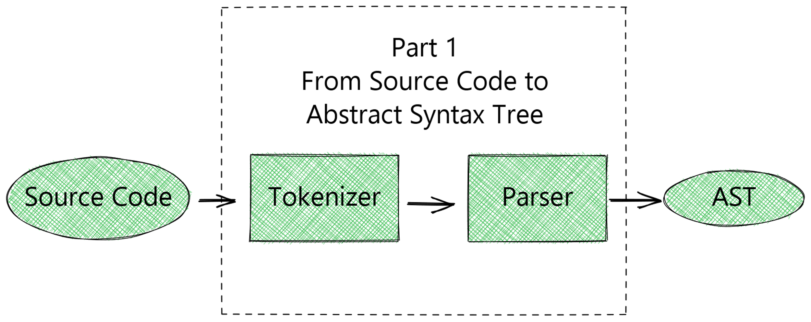
Part 1: Done

Slide 38
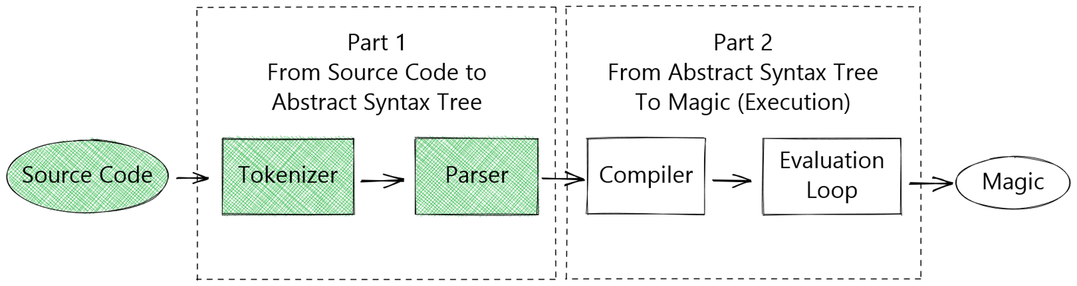
Progress
Now it's time for Part 2, which is where the magic happens.

Slide 39
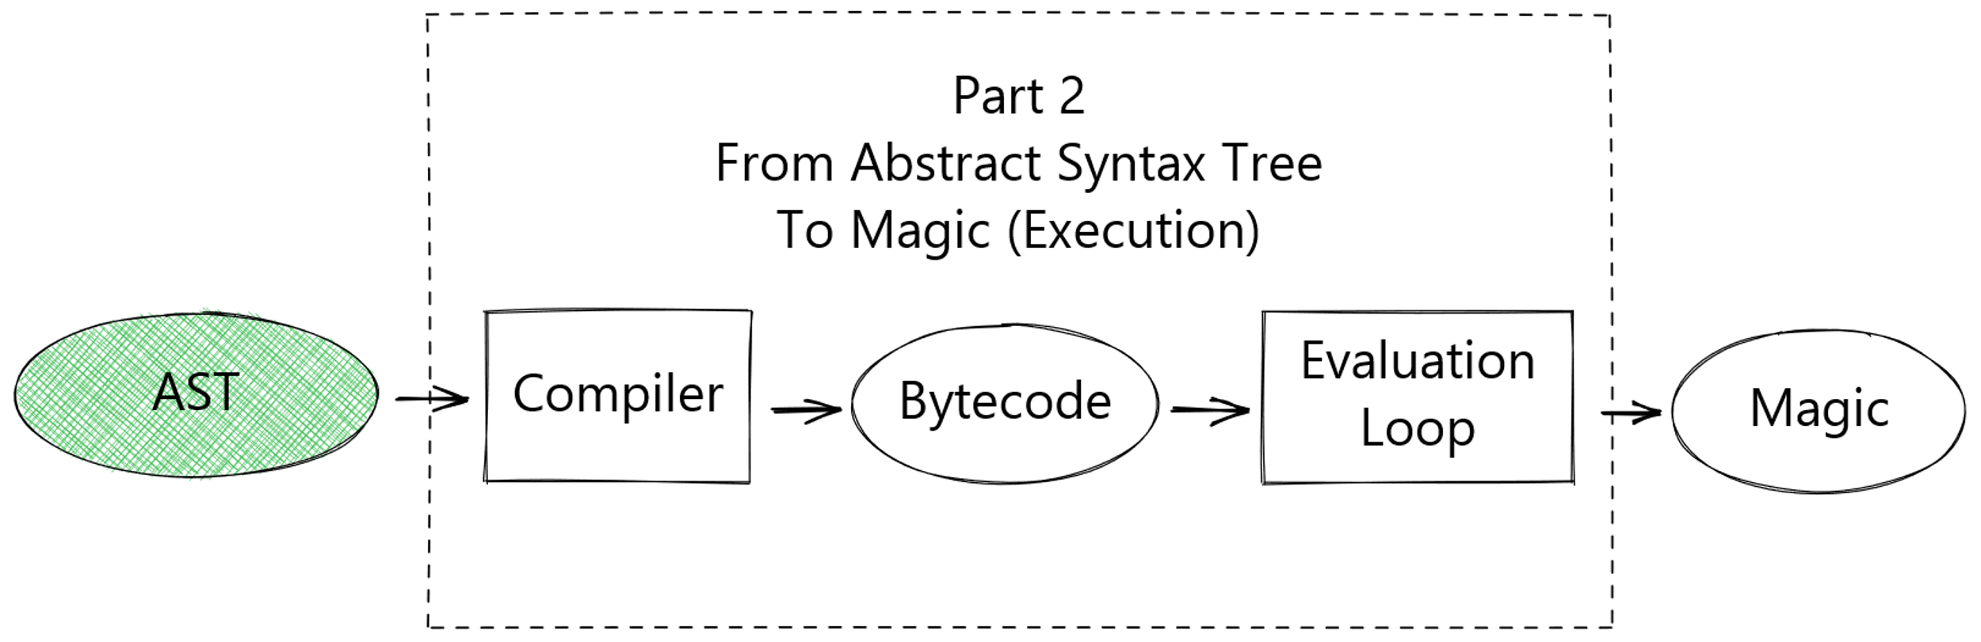
Part 2: From Abstract Syntax Tree to Magic (Execution)

Slide 40
Compiling the AST into Bytecode
The compiler takes the AST and turns it into bytecode
Bytecode consists of a list of instructions for the evaluation loop
Each unique instruction has its own "opcode" (operation code)
Let's add a new "opcode" for our new operator¹
1) I could have reused the "opcode" for calling a callable, but that's no fun...

Slide 41
File: Lib/opcode.py
def_op('POP_EXCEPT', 89)
# Opcodes from here have an argument:
HAVE_ARGUMENT = 90
name_op('STORE_NAME', 90)
name_op('DELETE_NAME', 91)

Slide 42
File: Lib/opcode.py
def_op('POP_EXCEPT', 89)
def_op('BINARY_PIPE_CALL', 90)
# Opcodes from here have an argument:
HAVE_ARGUMENT = 91
name_op('STORE_NAME', 91)
name_op('DELETE_NAME', 92)
Linux/Mac
$ make regen-opcode
Windows
> PCBuild\build.bat

Slide 43
Making the compiler use the new "opcode"
File: Python/compile.c
static int
compiler_visit_expr1(struct compiler *c, expr_ty e)
{
switch (e->kind) {
/* Other cases removed */
case BinOp_kind:
VISIT(c, expr, e->v.BinOp.left);
VISIT(c, expr, e->v.BinOp.right);
ADDOP(c, binop(e->v.BinOp.op));
break;
/* Other cases removed */

Slide 44
Making the compiler use the new "opcode"
File: Python/compile.c
static int
compiler_visit_expr1(struct compiler *c, expr_ty e)
{
switch (e->kind) {
/* Other cases removed */
case BinOp_kind:
VISIT(c, expr, e->v.BinOp.left);
VISIT(c, expr, e->v.BinOp.right);
ADDOP(c, binop(e->v.BinOp.op));
break;
/* Other cases removed */

Slide 45
Making the compiler use the new "opcode"
File: Python/compile.c
static int
binop(operator_ty op)
{
switch (op) {
case Add:
return BINARY_ADD;
case Sub:
return BINARY_SUBTRACT;
/* And so on */

Slide 46
Making the compiler use the new "opcode"
File: Python/compile.c
static int
binop(operator_ty op)
{
switch (op) {
case Add:
return BINARY_ADD;
case Sub:
return BINARY_SUBTRACT;
/* And so on */

Slide 47
Making the compiler use the new "opcode"
File: Python/compile.c
static int
binop(operator_ty op)
{
switch (op) {
case Add:
return BINARY_ADD;
case Sub:
return BINARY_SUBTRACT;
/* And so on */

Slide 48
Making the compiler use the new "opcode"
File: Python/compile.c
static int
binop(operator_ty op)
{
switch (op) {
case Add:
return BINARY_ADD;
case Sub:
return BINARY_SUBTRACT;
case CallPipe:
return BINARY_PIPE_CALL;
/* And so on */

Slide 49
Making the compiler use the new "opcode"
File: Python/compile.c
static int
stack_effect(int opcode, int oparg, int jump)
{
switch (opcode) {
/* Binary operators (most removed) */
case BINARY_ADD:
case BINARY_SUBTRACT:
case BINARY_TRUE_DIVIDE:
case BINARY_PIPE_CALL:
return -1;

Slide 50
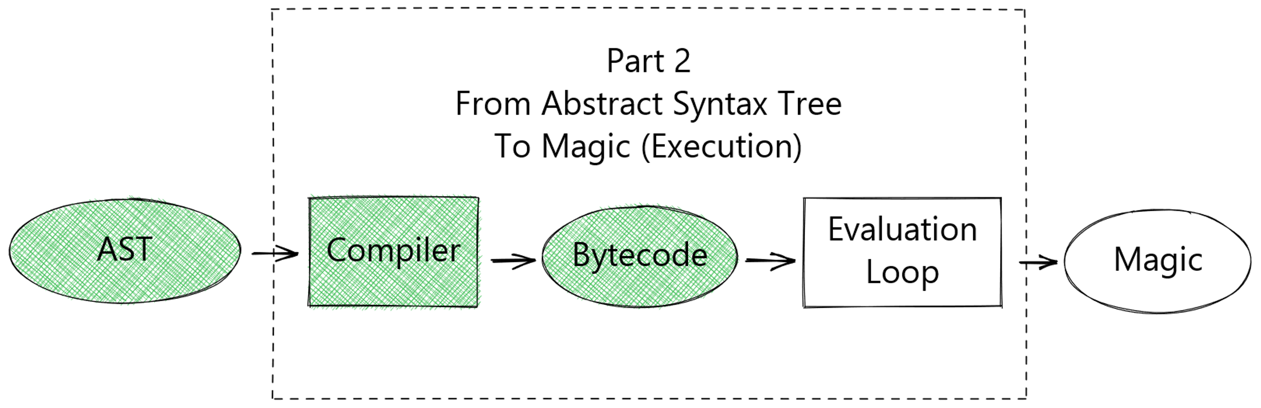
Part 2: We've got Bytecode!
Now, we get to where the magic happens: the Evaluation Loop.

Slide 51
File: Python/ceval.c
case TARGET(BINARY_SUBTRACT): {
PyObject *right = POP();
PyObject *left = TOP();
PyObject *res = PyNumber_Subtract(left, right);
Py_DECREF(right);
Py_DECREF(left);
SET_TOP(res);
if (res == NULL)
goto error;
DISPATCH();
}

Slide 52
File: Python/ceval.c
case TARGET(BINARY_SUBTRACT): {
PyObject *right = POP();
PyObject *left = TOP();
PyObject *res = PyNumber_Subtract(left, right);
Py_DECREF(right);
Py_DECREF(left);
SET_TOP(res);
if (res == NULL)
goto error;
DISPATCH();
}
4
-
3
Value Stack

Slide 53
File: Python/ceval.c
case TARGET(BINARY_SUBTRACT): {
PyObject *right = POP();
PyObject *left = TOP();
PyObject *res = PyNumber_Subtract(left, right);
Py_DECREF(right);
Py_DECREF(left);
SET_TOP(res);
if (res == NULL)
goto error;
DISPATCH();
}
4
-
3
Value Stack

Slide 54
File: Python/ceval.c
case TARGET(BINARY_SUBTRACT): {
PyObject *right = POP();
PyObject *left = TOP();
PyObject *res = PyNumber_Subtract(left, right);
Py_DECREF(right);
Py_DECREF(left);
SET_TOP(res);
if (res == NULL)
goto error;
DISPATCH();
}
-
3
4
Value Stack

Slide 55
File: Python/ceval.c
case TARGET(BINARY_SUBTRACT): {
PyObject *right = POP();
PyObject *left = TOP();
PyObject *res = PyNumber_Subtract(left, right);
Py_DECREF(right);
Py_DECREF(left);
SET_TOP(res);
if (res == NULL)
goto error;
DISPATCH();
}
3
4
Value Stack

Slide 56
File: Python/ceval.c
case TARGET(BINARY_SUBTRACT): {
PyObject *right = POP();
PyObject *left = TOP();
PyObject *res = PyNumber_Subtract(left, right);
Py_DECREF(right);
Py_DECREF(left);
SET_TOP(res);
if (res == NULL)
goto error;
DISPATCH();
}
1
4
3
1
3
4
Value Stack

Slide 57
File: Python/ceval.c
case TARGET(BINARY_PIPE_CALL): {
PyObject *right = POP();
PyObject *left = TOP();
PyObject *res = PyNumber_Subtract(left, right);
Py_DECREF(right);
Py_DECREF(left);
SET_TOP(res);
if (res == NULL)
goto error;
DISPATCH();
}

Slide 58
File: Python/ceval.c
case TARGET(BINARY_PIPE_CALL): {
PyObject *right = POP();
PyObject *left = TOP();
PyObject *res = PyObject_CallOneArg(right, left);
Py_DECREF(right);
Py_DECREF(left);
SET_TOP(res);
if (res == NULL)
goto error;
DISPATCH();
}

Slide 59
File: Python/ceval.c
case TARGET(BINARY_PIPE_CALL): {
PyObject *right = POP();
PyObject *left = TOP();
PyObject *res = PyObject_CallOneArg(right, left);
Py_DECREF(right);
Py_DECREF(left);
SET_TOP(res);
if (res == NULL)
goto error;
DISPATCH();
}
10 |> double

Slide 60
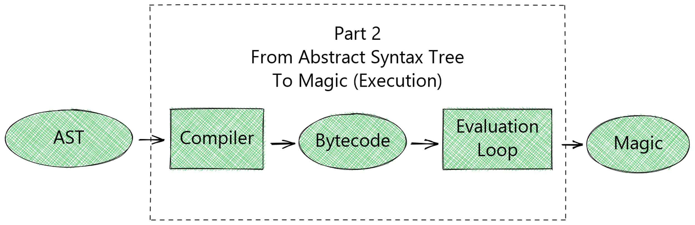

Slide 61
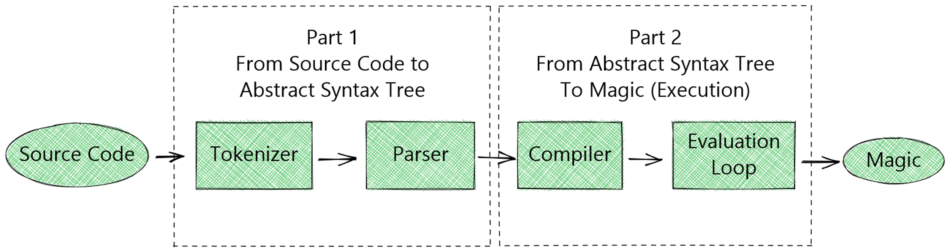

Slide 62

Let's compile and run it!
Linux/Mac
$ make -j2
Windows
> PCbuild\build.bat -d -p x64
https://xkcd.com/303/
CC BY-NC 2.5
Pypethon 3.9.9
>>> def double(number):
... return number * 2
>>> 1 |> double |> double |> double |> double
16

Slide 63
Recap & Remarks
We've seen a lot of CPython Internals in a short time
Source code & slides are available online:
https://github.com/SebastiaanZ/pypethon
If you get weird errors:
Try running make clean or PCBuild\build.bat -t CleanAll
Look into the MAGIC_NUMBER to version bytecode

Slide 64
Before we go...
https://europython.eu

Slide 65


Demystifying Python’s Internals
Diving into CPython by implementing a pipe operator
Sebastiaan Zeeff
Get in touch with me:
LinkedIn: https://www.linkedin.com/in/sebastiaanzeeff/
Python Discord: https://discord.com/invite/python (Sebastiaan#0008)
Twitter: https://twitter.com/SebastiaanZeeff (@SebastiaanZeeff)

Slide 66
Addendum: What about existing .pyc files?
Old bytecode will no longer work, as opcodes have changed.
To force recompilation, you can increase the "MAGIC_NUMBER"
Relevant file: Lib/importlib/_bootstrap_external.py
You may also need to update "magic_values" in PC/Launcher.c to include the new value in the specified range.
Run make regen-importlib or PCBuild\build.bat --regen

